Slide 1
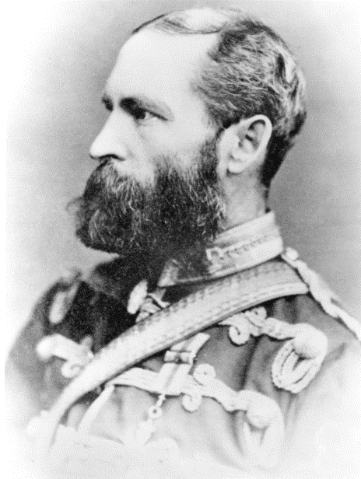
BRINGING ALBERTA HISTORY TO LIFE
Grades 4 to 9
Presented by Pat Christie
Executive Administrator, Alberta Champions
February 15, 2018

Slide 2

Background to
Alberta Champions Society
Founded by Gordon Hoffman 2003
“Fields of Fame” to honour lifetime achievements of Alberta “Champions”
Annual Story and Essay Contest

Slide 3
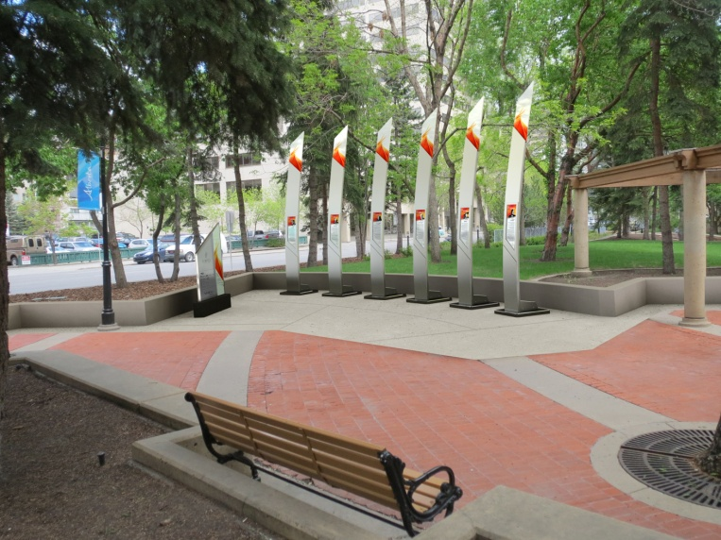
Fields of Fame
6 locations
  Jamieson Place
  Harley Hotchkiss Park
  Hyatt Regency
  McDougall Centre
  Heritage Park
  Spruce Meadows (in development phase)
Honouring 6 “champions” at each site-chosen by Nominating Committee

Slide 4
Engaging with Champions
Via a Contest
15 people with significant accomplishments:
David Black | Sam Livingston
Martha Cohen | Peter Lougheed
Chief Crowfoot | James Macleod
Mary Dover | Bud McCaig
Haider Dhanani | Nellie McClung
Ruth Gorman | Ron Southern
Alice Jamieson | Chief Walking Buffalo
Father Albert Lacombe

Slide 5
Guidelines for the Contest
Grades 4 to 6
  Write a story
  Where did you meet your character?
Grades 7 to 9
  Write an essay
  Dealing with a current political issue
All grades: inspired to be a “champion”
Check the contest rules and rubric www.albertachampions.org

Slide 6
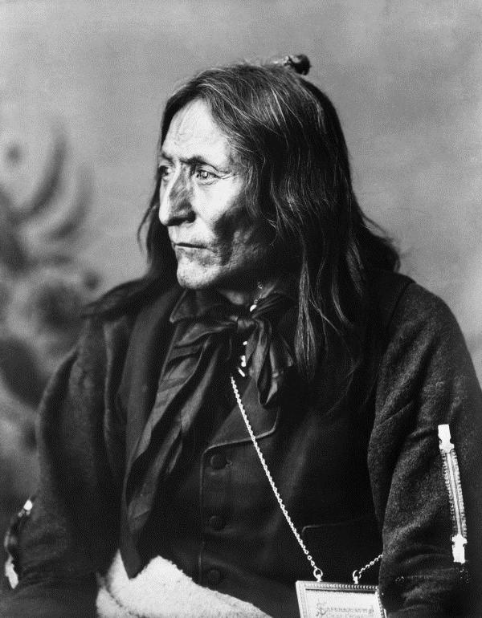
Bringing The Champions to Life
Inspiration for the class:
  Quiz on recognizing all champions
  Dramatize meeting champion
  Related art project
  Visit the Fields of Fame
  Find evidence of current impact
  “Everyday Champions” program
  Nominate a champion
  Become a published author
  --

Slide 7
Bringing One Champion to Life
Project
  Which individual inspires me?
  Research champion
  How did champion help the community? Me?
  Where will I meet my champion?/ or what issue was important then and now?
  Make the links between champion and today
  How champion inspires me in social action, becoming a leader

Slide 8
Fit With Cross-Curricular Work
Grades 4 and 5 Social Studies- history and stories, Alberta, Canada
Grade 5 – Canadian Women in History
Grade 6 – Citizenship, democracy
Grade 7 and 9- Canada
Language Arts
  Stories, essays
  Research and references
  Become a published author

Slide 9
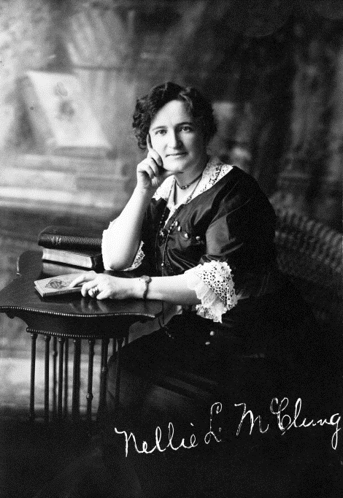
Becoming a Published Winning Author
Last year’s essay winner Grade 7 to 9- Anika Islam
Why did she enter?
What were her challenges and learnings?

Slide 10

Helping Your Students Bring History to Life
Use the contest to encourage knowledge of Alberta history
Galvanize social action
Rules and rubric
Deadline-April 19, 2018
Prizes as motivation!!!

Slide 11
Follow Up
Follow us on Facebook and Twitter to get updates on the contest, everyday champions, and future champions.
Session and contest materials are on our website
www.albertachampions.org
Pat Christie, Executive Administrator
Alberta Champions Society
Pat.Christie@telus.net

